Slide 1

Lecture 5-2 Board Definition Files, Clocks and AXI4
References
Board Definition or Interface Files for Zybo
Board Definition File Version B.3
C:\Xilinx\Vivado\2015.2\data\boards\board_parts\zybo\B.3
Clocks
Clock specifications in preset.xml for Zybo
PS7 Clock Configuration Tab
Basic Concepts of Interfaces
Read and Write
Interconnect crossbar
Interfaces – Master and Slave
AXI4-Lite and AXI4

Slide 2
References
Creating and Adding Custom IP, Zynq, Vivado 2014.2 Version, PPT
How to Use the Three AXI Configurations, Xilinx, PPT
Embedded System Design Flow on Zynq using Vivado, Xilinx University Program Workshop
AXI Reference Guide, UG761 (v13.4) January 18, 201, Xilinx
ZYNQ Book Tutorials
Tutorial 4: IP Creation
Exercise 4A: Creating IP in HDL
The ZYNQ Book – Chapter 19, AXI Interfacing
ARM AMBA AXI Protocol v1.0: Specification
Chapter 1: Introduction
Chapter 2: Signal Descriptions
Chapter 3: Channel Handshake
Chapter 4: Addressing Options
Chapter 9: Data Buses

Slide 3
Recommended Reading
P. Schaumont, A Practical Introduction to Hardware/Software Codesign, 2nd Ed.
Chapter 10: On-Chip Buses
M.S. Sadri, ZYNQ Training (presentations and videos)
Lesson 1 : What is AXI?
Lesson 2 : What is an AXI Interconnect?
Lesson 3 : AXI Stream Interface

Slide 4
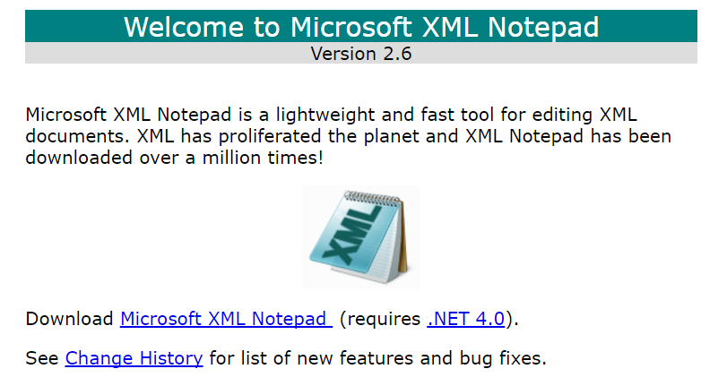
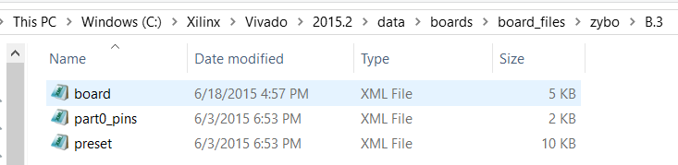
Microsoft XML Notepad and Zybo Board Files B.3
Microsoft XML Notepad can read and edit a *.xml file
Microsoft XML Notepad 2007
To review board definition files
Original author(s) Chris Lovett, Michael Corning, Dan Doris
Developer(s) Microsoft
initial release, 1 September 2006
http://www.lovettsoftware.com/downloads/xmlnotepad/readme.htm
The Board definition or Interface files in XML format to define information about system-level boards
Zybo Board Definition Files Version B.3 is a subset of the whole board
Board files for Digilent boards are available at https://github.com/Digilent/vivado-boards/

Slide 5
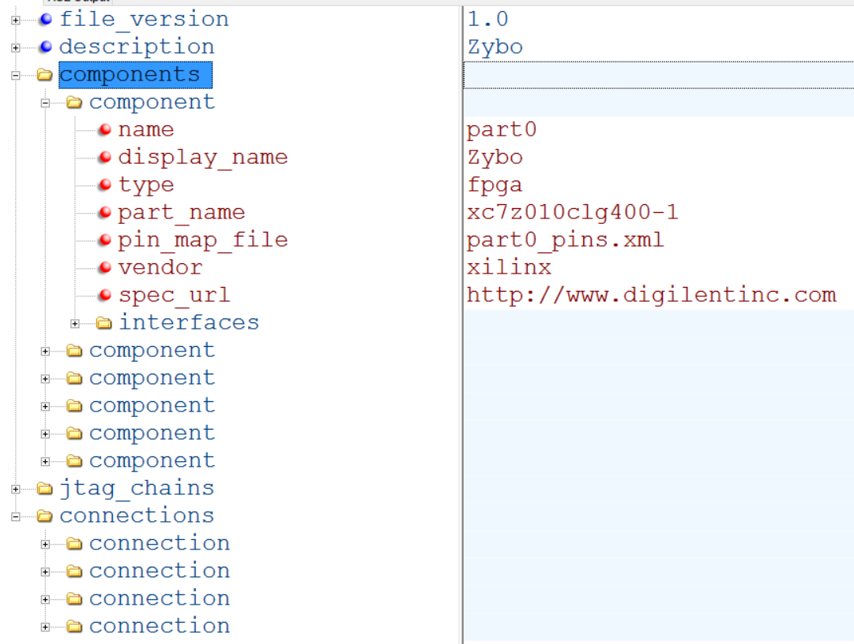
View of board.xml File for Zybo Seen by XML Notepad
Six components, four connections, five interfaces
ug895-vivado-system-level-design-entry

Slide 6
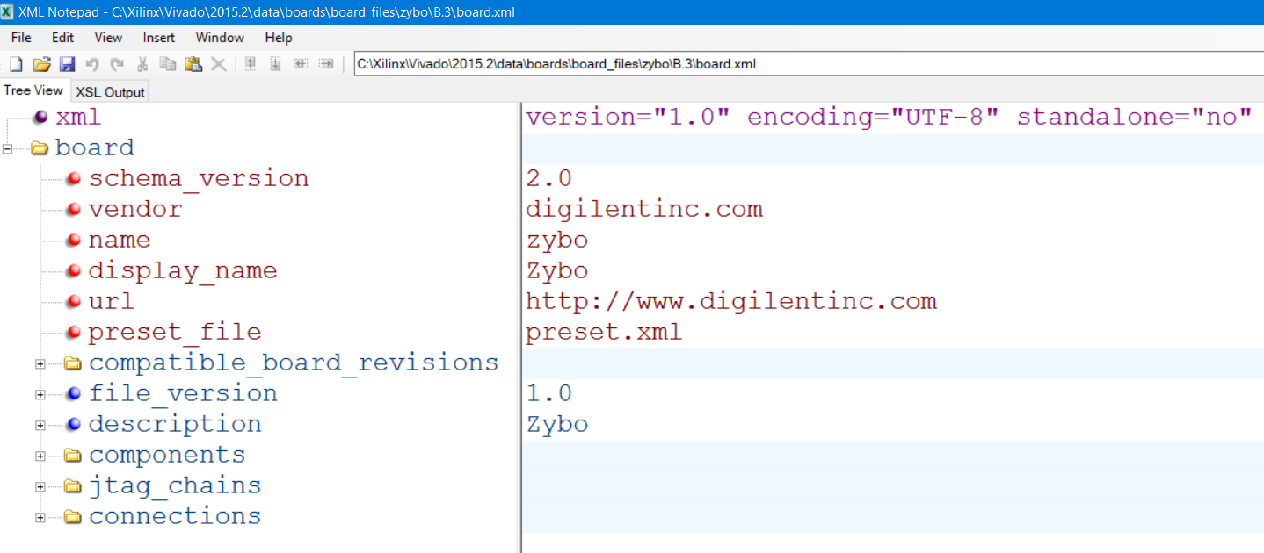
The Board Definition Files for Zybo Version B.3: board.xml
board.xml contains all logical components, connectivity,
Clock, Slide Switches, Push Buttons, LEDs, USB-UART, DDR Memory, Ethernet
Components are block components
Connections define how logical wires are tied to physical wires
Interfaces define names of logical pins and ports that are composed of pins.
Interfaces in B.3 are under component part0

Slide 7
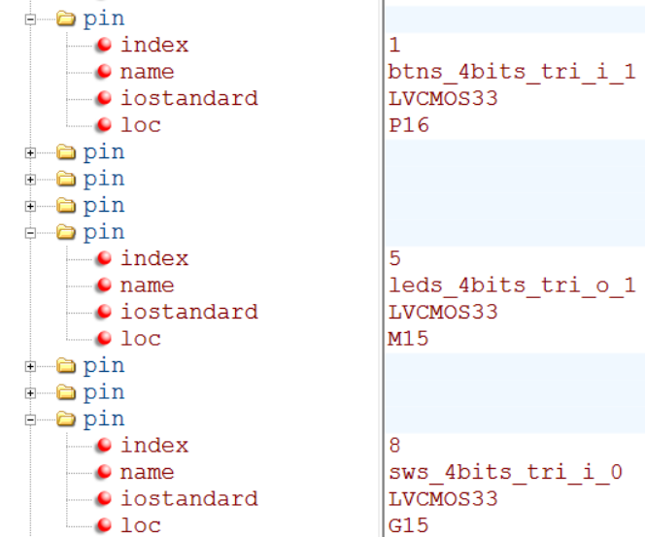
The Board Definition Files for Zybo B.3: part0_pins.xml
part0_pins.xml – Define logical wire to physical pin connections
defines every physical pin
Pin number
Logical name
IO standard: LVCMOS33 e.g.
Physical location of the pin on the chip

Slide 8
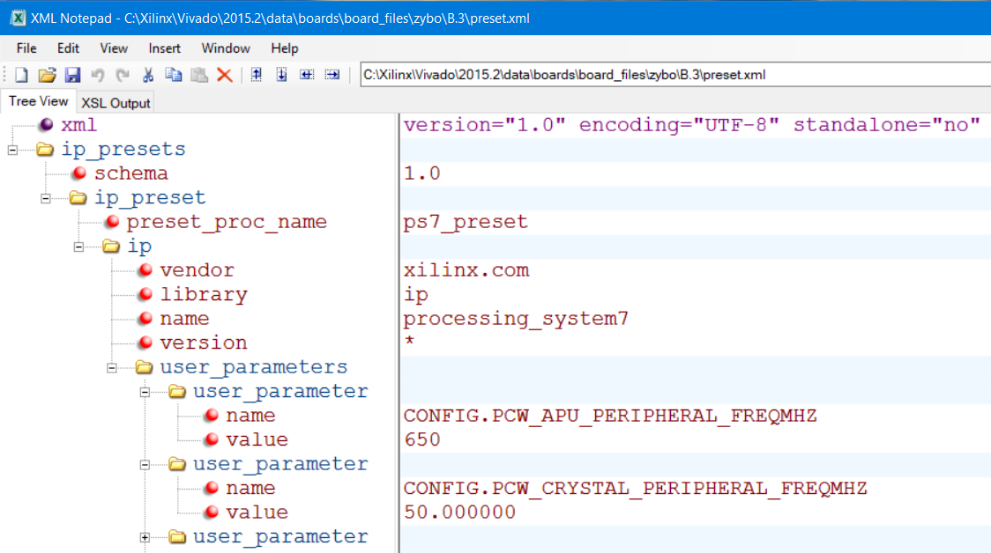
The Board Definition Files for Zybo B.3: preset.xml
preset.xml - Default clock frequencies and MIO pin configurations in preset.xml
System clock speed is 650 MHz and crystal speed is 50 MHz

Slide 9
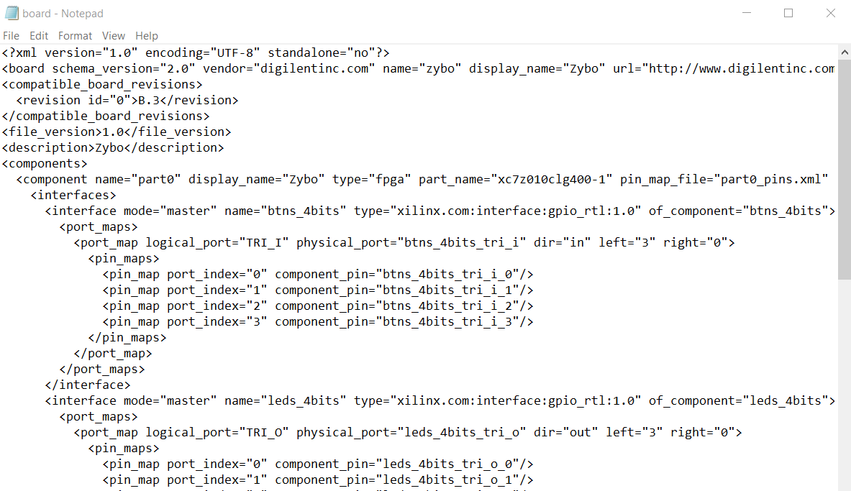
Text board.xml File for Zybo Version B.3
ug895-vivado-system-level-design-entry

Slide 10
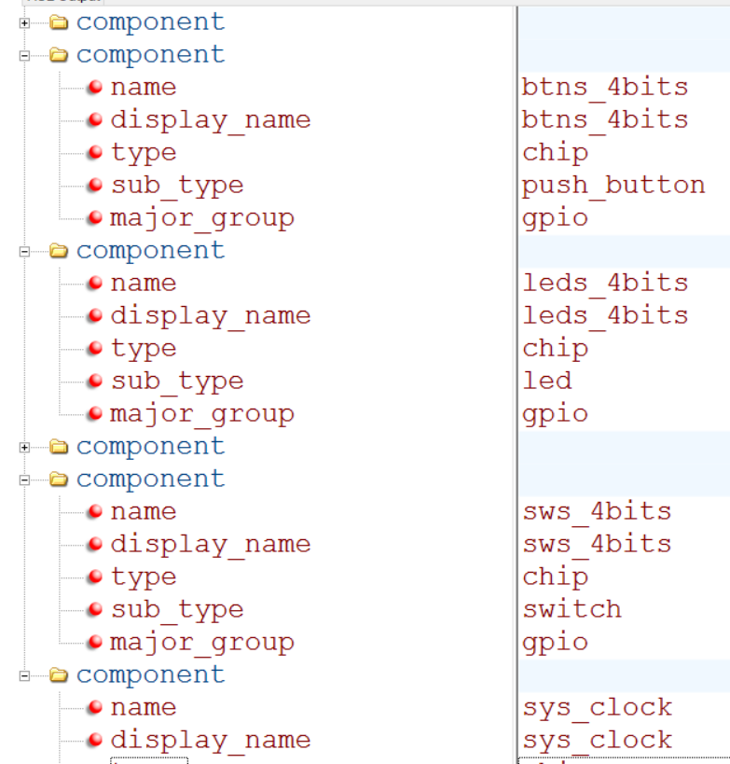
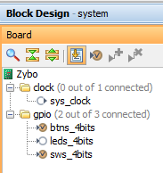
board.xml (B.3): Six Components
Part0 – chip and board name and interfaces, CPU part number
Push buttons
LEDs
Ps7_fixedio
Slide switches
System clock
ug895-vivado-system-level-design-entry

Slide 11
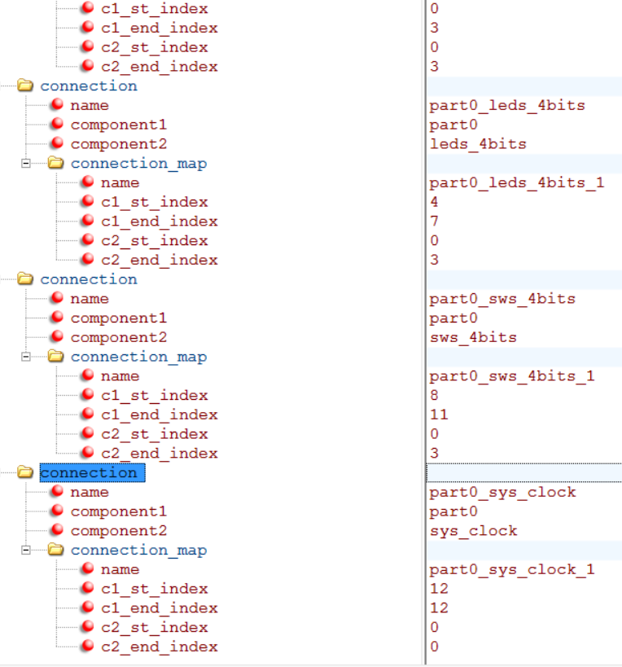
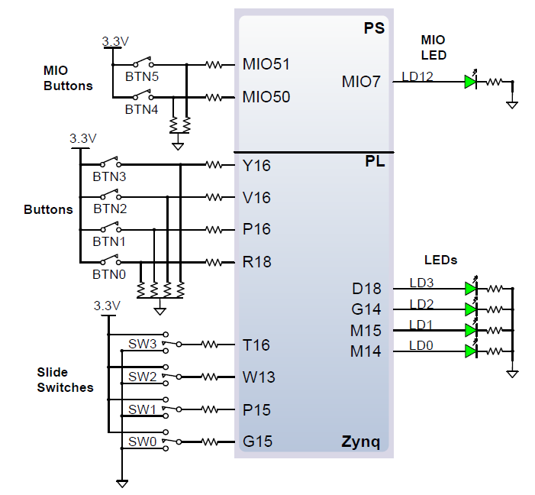
board_part.xml (B.3): Four Connections
Push buttons
LEDs
Slide switches
System clock
ug895-vivado-system-level-design-entry

Slide 12
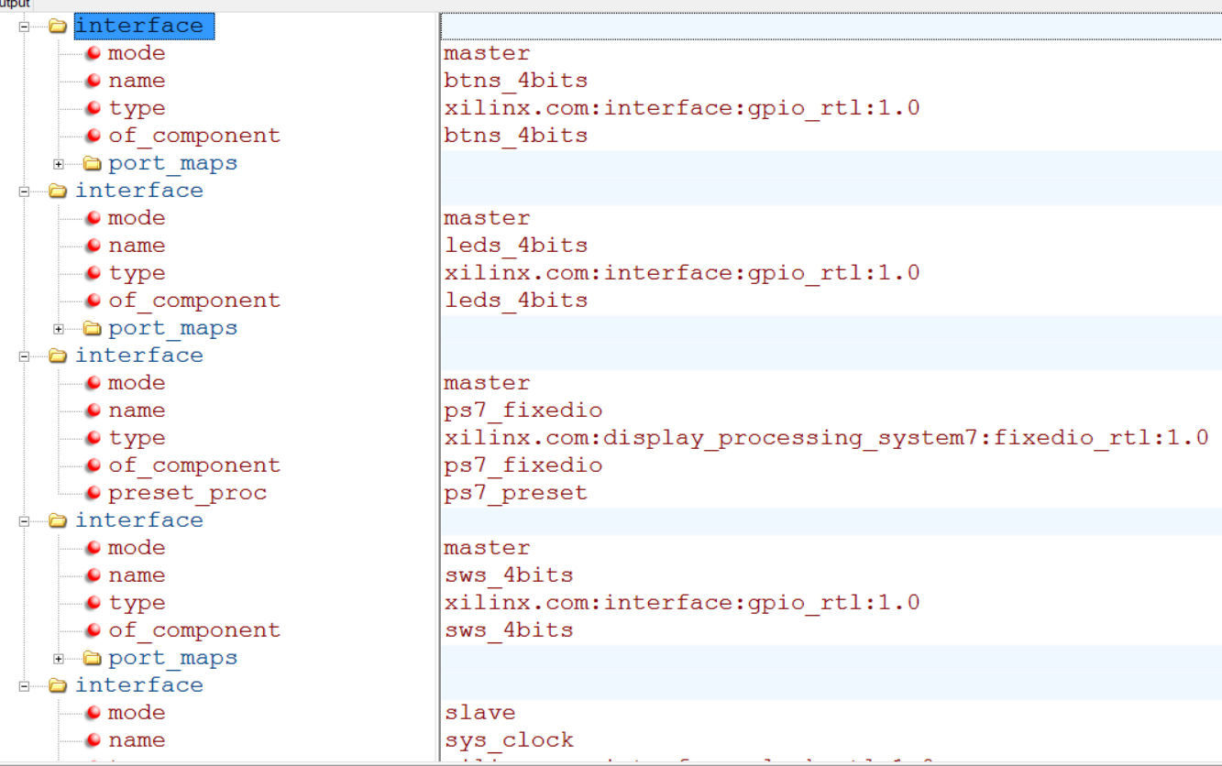
board_part.xml (B.3): Five Interfaces
Push buttons
LEDs
Ps7_fixedio
Slide switches
System clock
ug895-vivado-system-level-design-entry

Slide 13
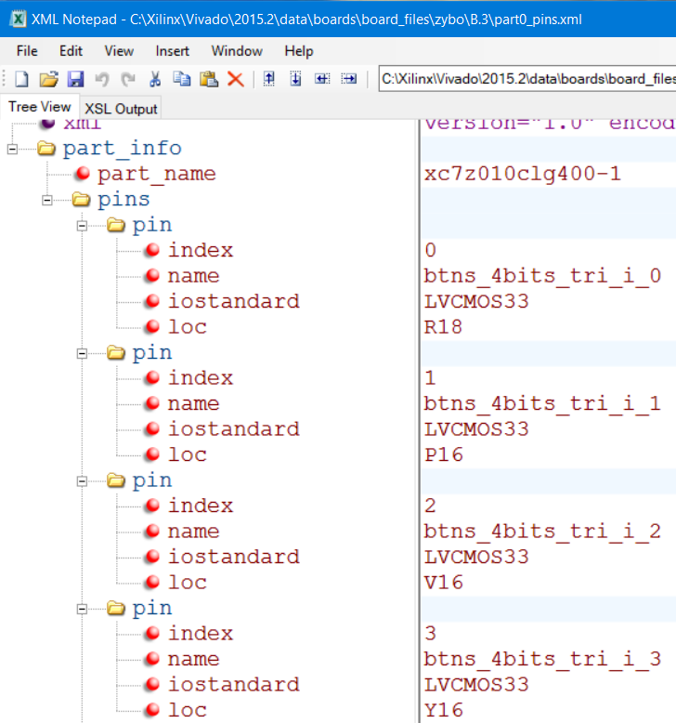
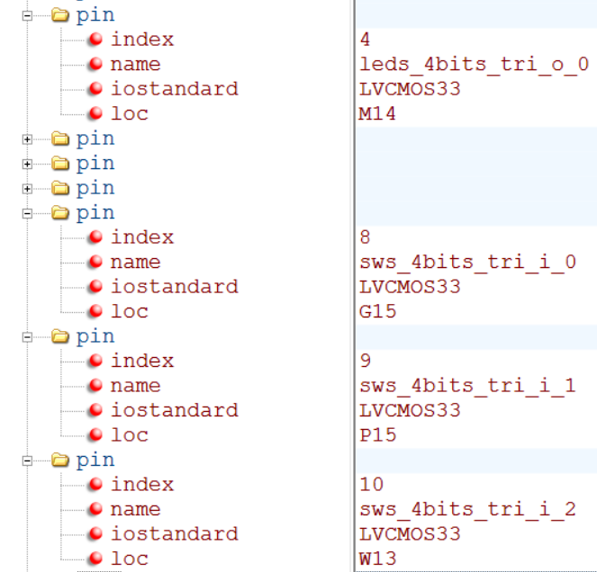
The Board Definition Files for Zybo B.3: part0_pins.xml
Nine pins are defined in part0_pins.xml

Slide 14
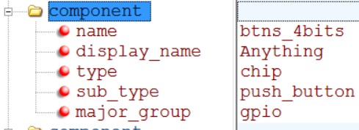
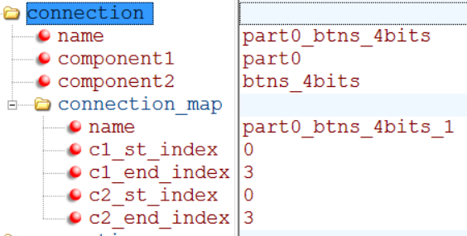
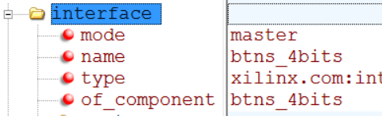
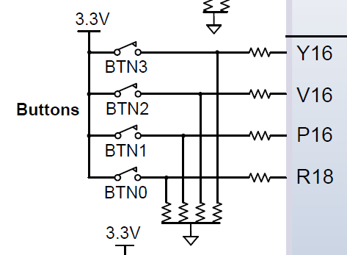
Naming Convention of Board Definition Files: buttons
Display name can be anything, btsn_4bits is not necessary
Component name: btns_4bits (btns is a predefined for buttons)
Names of interface and connection match component name
board.xml
part0_pins.xml
interface
component
Y16
V16
P16
R18
btns_4bits_tri_i_3
btns_4bits_tri_i_2
btns_4bits_tri_i_1
btns_4bits_tri_i_0
btns_4bits, gpio
component 1
connection
component 2

Slide 15
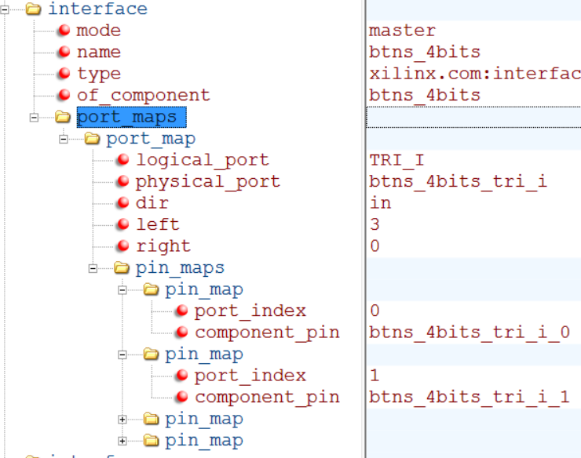
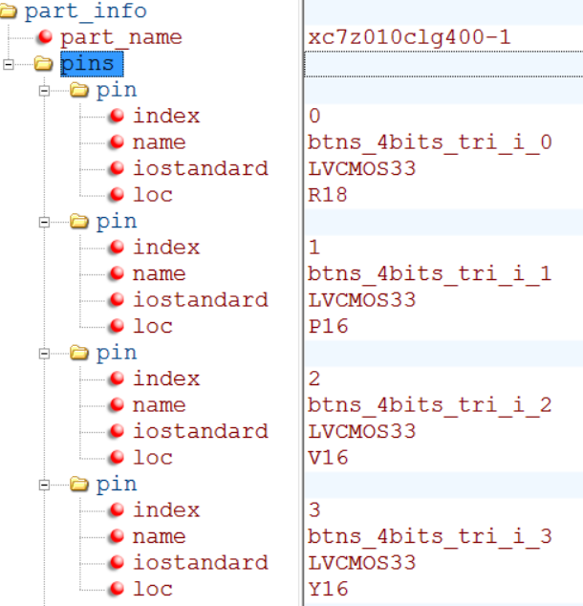
Naming Convention of Board Definition Files
Port and pin names use interface name as prefix:
Port - btns_4bits_tri_i
Pin 0 - btns_4bits_tri_i_0
Pin names are used in part0_pins.xml to map them to physical pins
Pin 0 btns_4bits_tri_i_0 -> R18
board.xml
part0_pins.xml

Slide 16
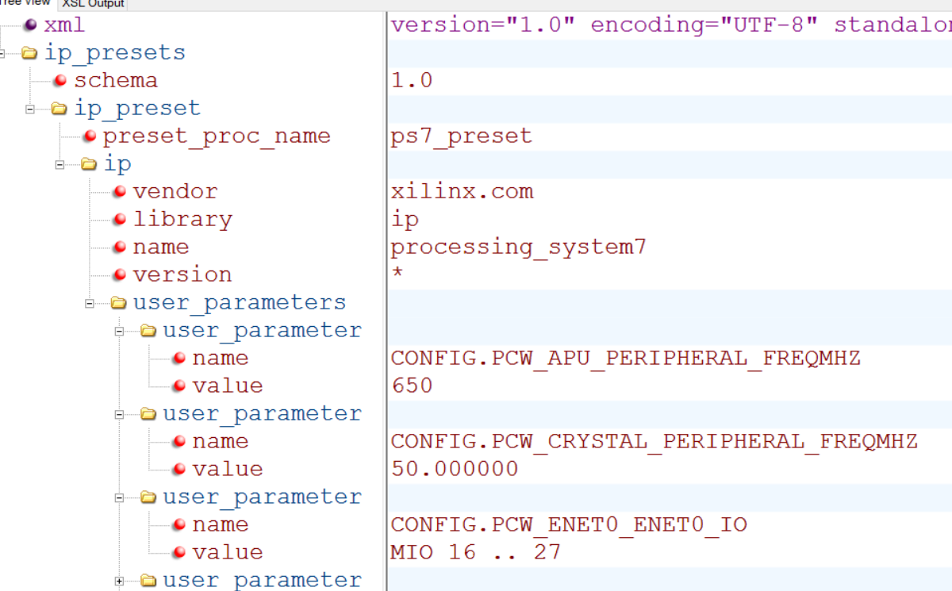
The Board Definition Files for Zybo B.3: preset.xml
Default clock frequencies and MIO pin configurations in preset.xml
CPU clock frequency is 650MHz. External crystal is 50MHz
Notes:
XDC constraints are a combination of: • Industry standard Synopsys Design Constraints (SDC), and • Xilinx proprietary physical constraints XDC constraints have the following properties: • They are not simple strings, but are commands that follow the Tcl semantic. • They can be interpreted like any other Tcl command by the Vivado Tcl interpreter. • They are read in and parsed sequentially the same as other Tcl commands.

Slide 17
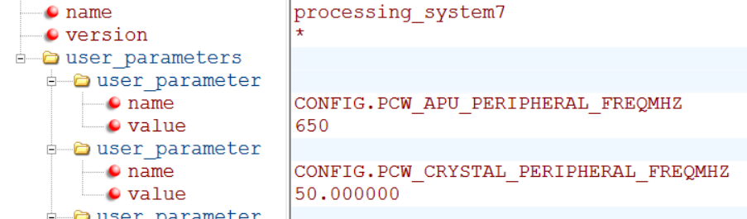
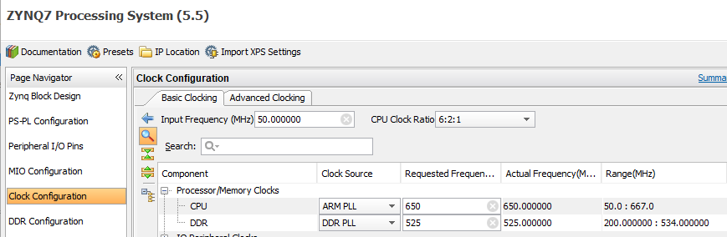
Clock Speeds in preset.xml
650MHz CPU clock and 50MHz crystal clock are given in preset.xml
PS7 of a block design reads these values to set its clocks
Notes:
XDC constraints are a combination of: • Industry standard Synopsys Design Constraints (SDC), and • Xilinx proprietary physical constraints XDC constraints have the following properties: • They are not simple strings, but are commands that follow the Tcl semantic. • They can be interpreted like any other Tcl command by the Vivado Tcl interpreter. • They are read in and parsed sequentially the same as other Tcl commands.

Slide 18
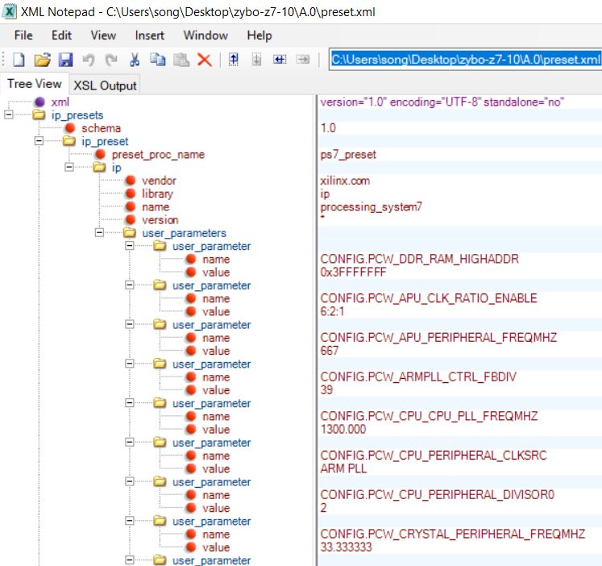
Zybo 7-10 Clock Speeds in preset.xml
667MHz CPU clock and 33.33MHz crystal clock are given in preset.xml
PS7 of a block design reads these values to set its clocks
Notes:
XDC constraints are a combination of: • Industry standard Synopsys Design Constraints (SDC), and • Xilinx proprietary physical constraints XDC constraints have the following properties: • They are not simple strings, but are commands that follow the Tcl semantic. • They can be interpreted like any other Tcl command by the Vivado Tcl interpreter. • They are read in and parsed sequentially the same as other Tcl commands.

Slide 19
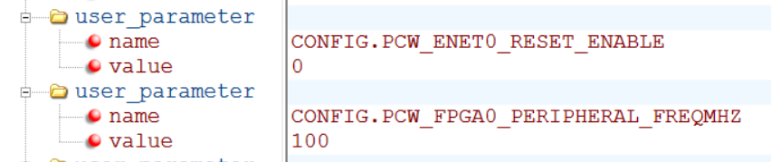
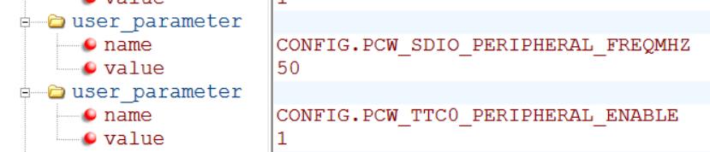
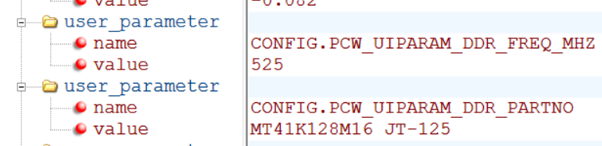
Clock Speeds in preset.xml
100 MHz FPGA clock, 50 MHz SDI clock
525 MHz RAM clock and DDR part number MT41K128M16 JT-125
Notes:
XDC constraints are a combination of: • Industry standard Synopsys Design Constraints (SDC), and • Xilinx proprietary physical constraints XDC constraints have the following properties: • They are not simple strings, but are commands that follow the Tcl semantic. • They can be interpreted like any other Tcl command by the Vivado Tcl interpreter. • They are read in and parsed sequentially the same as other Tcl commands.

Slide 20
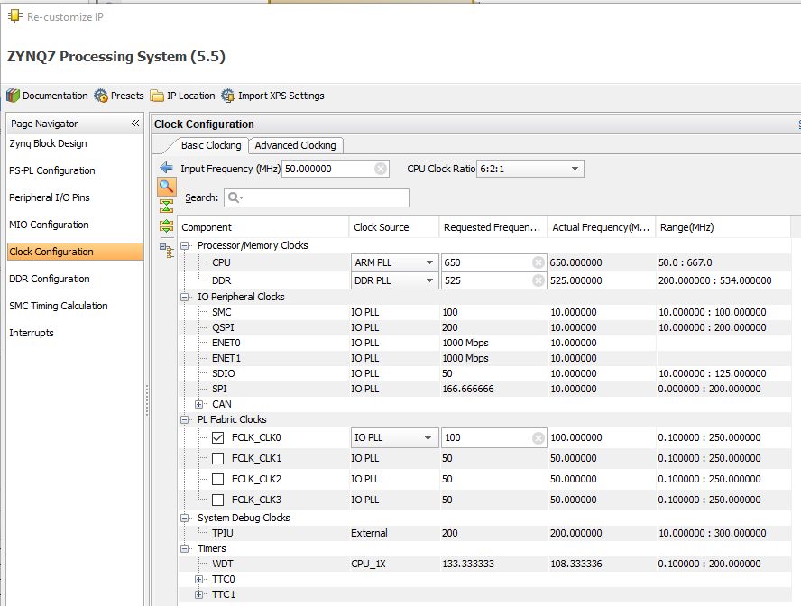
Clock Speeds in ps7 Block Clock Configuration for Zybo
Notes:
XDC constraints are a combination of: • Industry standard Synopsys Design Constraints (SDC), and • Xilinx proprietary physical constraints XDC constraints have the following properties: • They are not simple strings, but are commands that follow the Tcl semantic. • They can be interpreted like any other Tcl command by the Vivado Tcl interpreter. • They are read in and parsed sequentially the same as other Tcl commands.

Slide 21
PS and PL Clocking Sources
PS clocks
PS clock source from external package pin
PS has three PLLs for clock generation
PS has four clock ports to PL
The PL has 7 series clocking resources
PL has a different clock source domain compared to the PS
The clock to PL can be sourced from external clock capable pins
Can use one of the four PS clocks as source
Synchronizing the clock between PL and PS is taken care of by the architecture of the PS
PL cannot supply clock source to PS

Slide 22
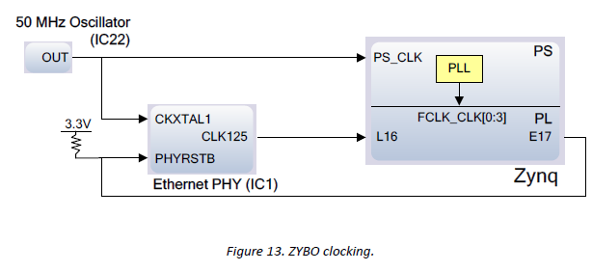
Zybo Clocking Sources: PS and PL
PS uses the 50MHz oscillator as its clock source
Maximum speed for PS is 650MHz
Maximum DDR3 speed is 525MHz (1050 Mbps)
PL Clocking Schemes
125MHz external clock on pin L16 (FPGA only), independent of PS, disabled if Ethernet PHY is held in hardware reset by pulling PHYRESTB low.
Four clock sources from PS

Slide 23
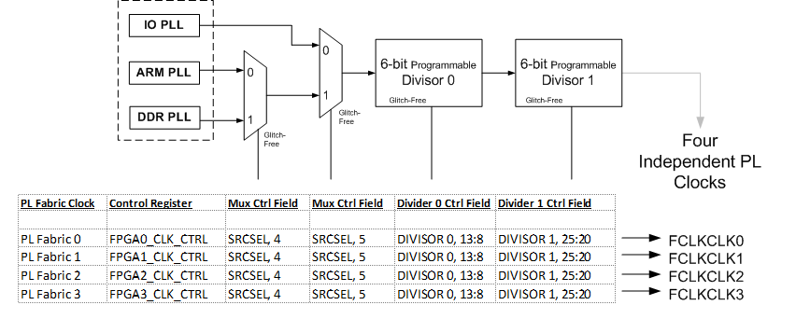
PS Clocking the PL: four clock sources FCLKCLK0-3

Slide 24
Clock Generation (Using Zynq Tab)
The Clock Generator allows configuration of PLL components for both the PS and PL
One input reference clock
Access GUI by clicking the Clock Generation Block, or select from Navigator
Configure the PS Peripheral Clock in the Zynq tab
PS uses a dedicated PLL clock
PS I/O peripherals use the I/O PLL clock and ARM PLL
External Clock of 125MHz to PL is disabled if PS clocking is present

Slide 25
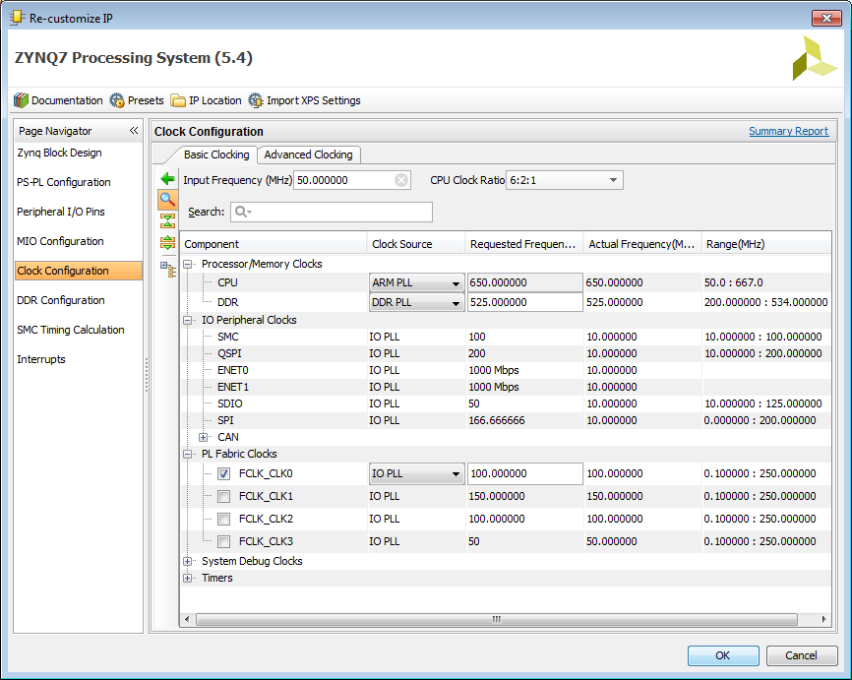
Basic Clocking in Zynq for Zybo Board

Slide 26
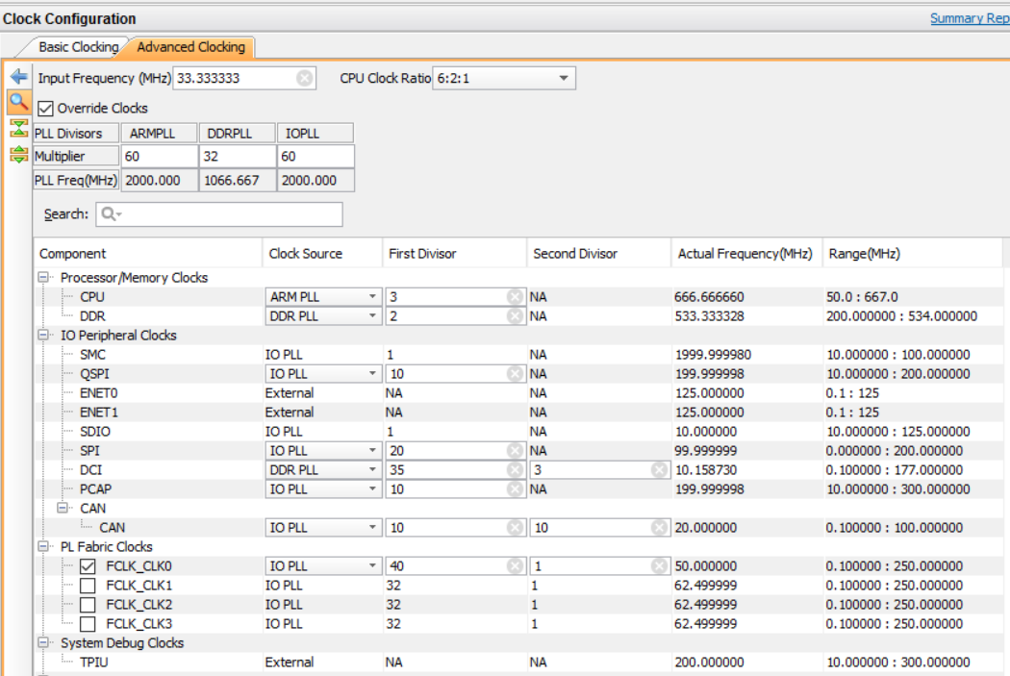
Advanced Clocking in Zynq: Input Clock=100/3 MHz
Input crystal frequency is 100/3=33.333 MHz
Phase Lock Loop Divisors: 60:32:60

Slide 27
Advanced Clocking in Zynq
Input Clock = 33.33MHz (100/3) //crystal oscillator source frequency
ARM PLL Clock = 60x33.33MHz=60x100/3=2000MHz
DDR PLL Clock = 32x33.33MHz=1066.667MHz
IO PLL Clock = 60x33.33MHz=2000MHz
CPU Clock = ARM PLL Clock/3=2000/3=666.67MHz
DDR Clock = DDR PLL Clock/2=1066.667/2=533.33MHz
FCLK_CLK0=IO PLL_Clock/40/1=2000MHz/40/1=50MHz

Slide 28

AXI (Advanced Extensible Interface) is Part of ARM’s AMBA
AMBA: Advanced Microcontroller Bus Architecture
AXI: Advanced Extensible Interface
APB
AHB
AXI
AMBA 3.0
(2003)
Older Performance Newer
© Copyright 2015 Xilinx

Slide 29
Three AXI-4 AXI Interfaces: Memory, Stream, Lite
AXI interfaces can be used by an AXI3-compliant master or slave to be connected to the ARM® core. The Xilinx PL-based cores use AXI4 or AXI4-Lite and require conversion, typically through an AXI interconnect core.
AMBA
APB
AHB
AXI
AXI-4
Memory Map
AXI-4
Stream
AXI-4
Lite
ATB
Enhancements for FPGAs
AMBA 3.0
(2003)
Same Spec
AMBA 4.0
(2010)
Interface | Features | Similar to
Memory Map / Full (AXI4) | Traditional Address/Data Burst (single address, multiple data) | PLBv46, PCI
Streaming (AXI4-Stream) | Data-Only, Burst | Local Link / DSP Interfaces / FIFO / FSL
Lite (AXI4-Lite) | Traditional Address/Data—No Burst (single address, single data) | PLBv46-single OPB
© Copyright 2015 Xilinx

Slide 30
Zynq-7000: PS-PL Interfaces, AXI 3.0, EMIO
Standard AXI 3.0 interfaces supported
AXI_GP, four general purpose ports, EMIO
Two, 32-bit master interfaces
Two, 32-bit slave interfaces
AXI_ACP for cache coherent
One 64-bit cache coherent master port in the PL
Connects to the snoop control unit for cache coherency between the CPUs and the PL
AXI_HP for memory
four high performance/bandwidth master ports in the PL
32-bit or 64-bit data master interfaces (independently programmed)

Slide 31
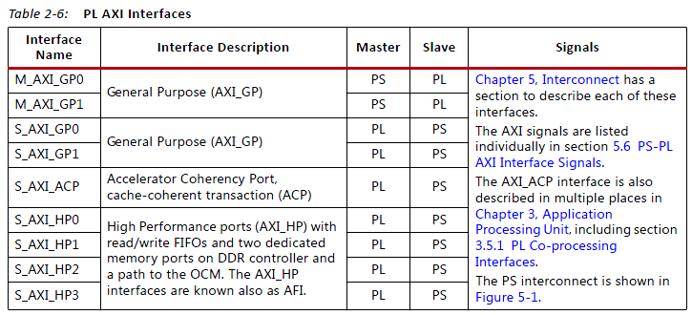
Extended MIO (EMIO) between PS and PL
AXI Interconnect
Extended MIO interfaces for most of the I/O Peripherals
Interrupts
MA flow control
Page 56, ug585-Zynq-7000-TRM

Slide 32
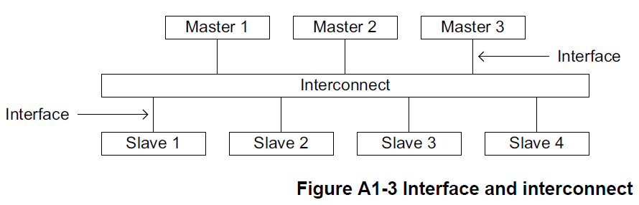
Interconnect vs. Interfaces, Read/Write Slave Addresses
Master Interface sends slave address and control
Master reads from slave
Master writes to slave
Slave Interface needs to respond to read and write operation
Interconnect – crossbar network to route signals
Page A1-23, AMBA AXI and ACE Protocol Specification, ARM 2011
Notes:
The AXI interface has separate and independent read and write channels that can be used simultaneously.
Each channel has its own address and data buses.
Both channels are non-posted; that is, there is always a response.
In the read case the response is simply the read data coming back.
For a write, a separate response bus acknowledges data delivery
Summary of the five AXI channels:
Read address channel
Read data channel
Write address channel
Write data channel
Write response channel

Slide 33
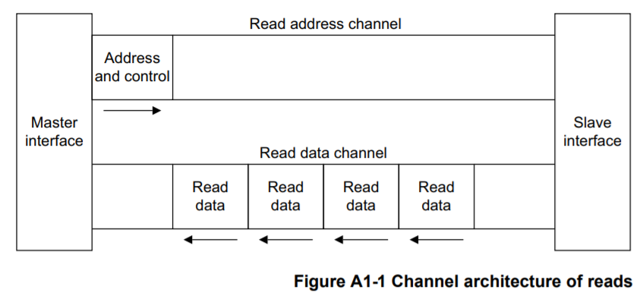
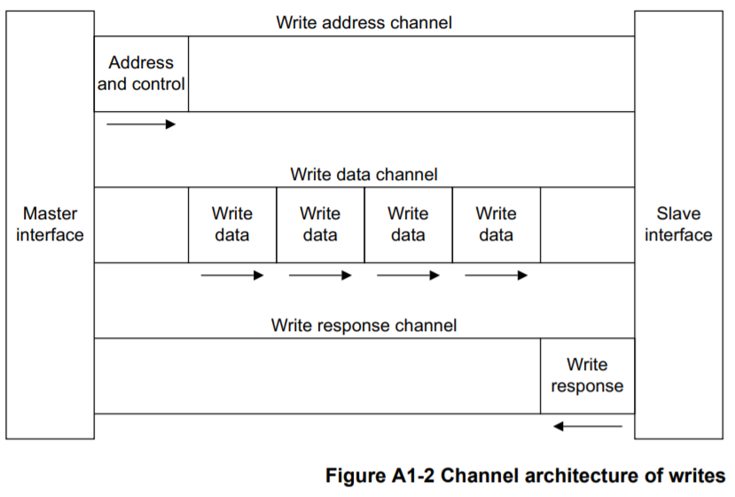
Basic AXI Signaling – 5 Channels Between Master and Slave
Read Address Channel
Read Data Channel
Write Address Channel
Write Data Channel
Write Response Channel
Page A1-22, AMBA AXI and ACE Protocol Specification, ARM 2011

Slide 34
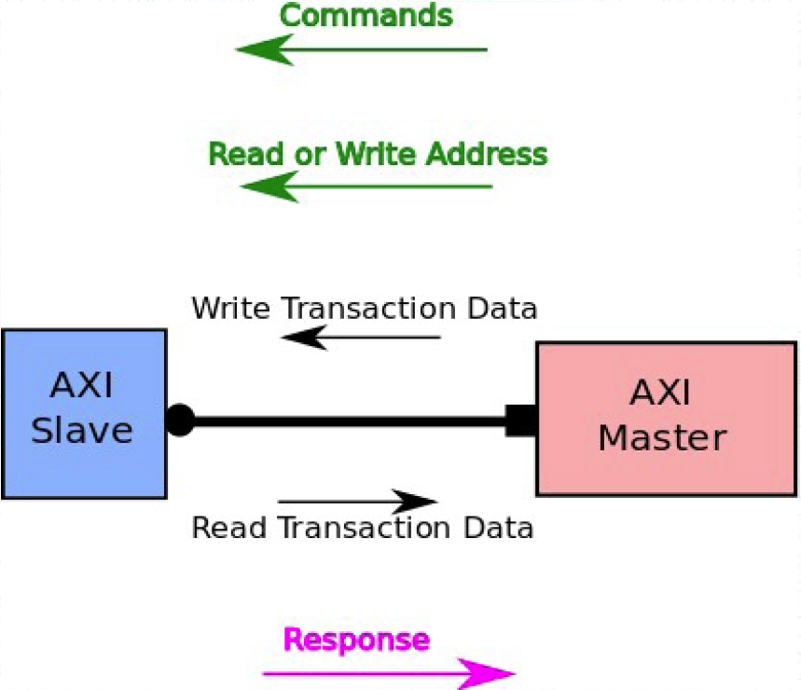
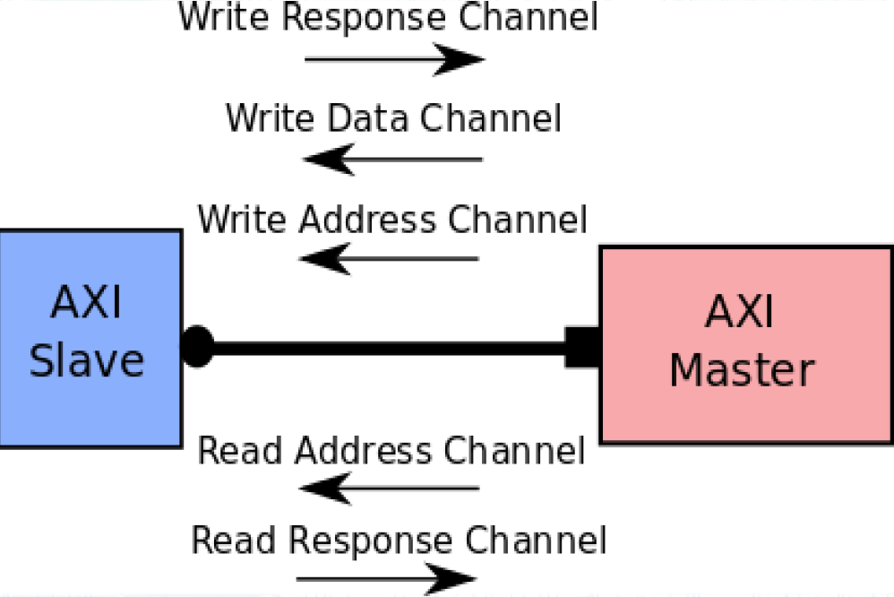
Basic Concepts of Interfaces
Transaction - Transfer of data from one point in the hardware to another point
Master – Initiates transaction
Slave – Responds to the initiated transaction
Communication between AXI Master and AXI Slave: Five Channels
Source: M.S. Sadri, Zynq Training
Notes:
The AXI interface has separate and independent read and write channels that can be used simultaneously.
Each channel has its own address and data buses.
Both channels are non-posted; that is, there is always a response.
In the read case the response is simply the read data coming back.
For a write, a separate response bus acknowledges data delivery
Summary of the five AXI channels:
Read address channel
Read data channel
Write address channel
Write data channel
Write response channel

Slide 35
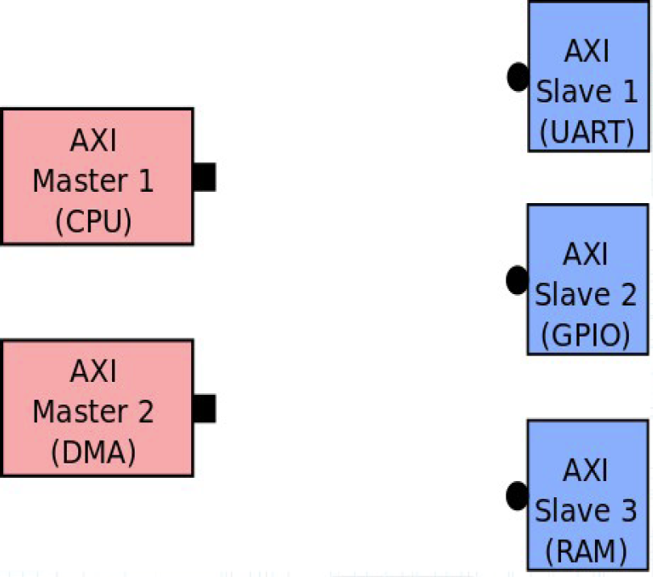
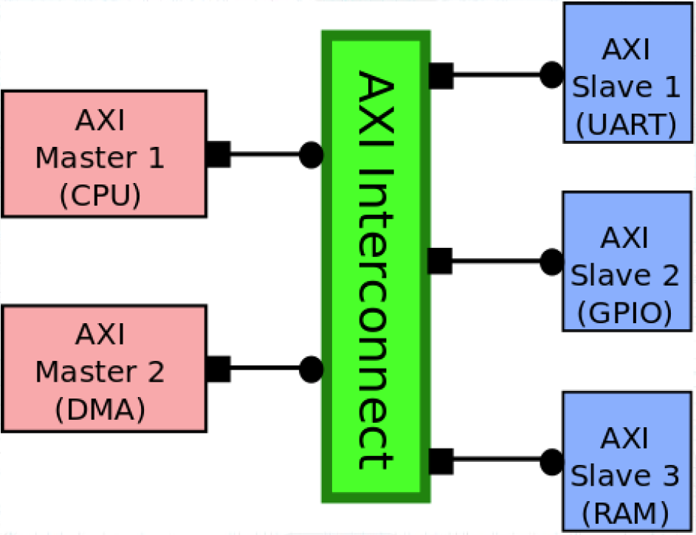
AXI Interconnect crossbar in between Interfaces
A transparent interconnect crossbar is needed to tie interfaces together
Source: M.S. Sadri, Zynq Training
Notes:
The AXI interface has separate and independent read and write channels that can be used simultaneously.
Each channel has its own address and data buses.
Both channels are non-posted; that is, there is always a response.
In the read case the response is simply the read data coming back.
For a write, a separate response bus acknowledges data delivery
Summary of the five AXI channels:
Read address channel
Read data channel
Write address channel
Write data channel
Write response channel

Slide 36
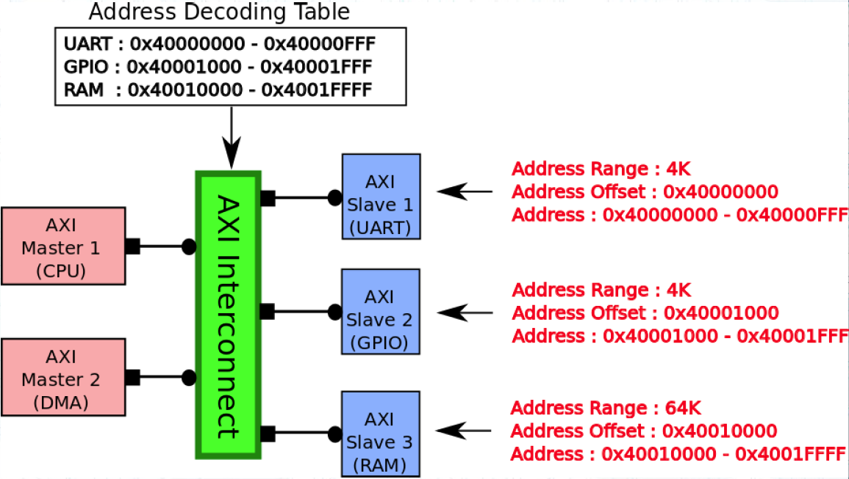
AXI Interconnect Address Decoding
AXI Interconnect knows how to route data based on their destination addresses.
Each address range is 4kB long
Page A1-23, AMBA AXI and ACE Protocol Specification, ARM 2011
Notes:
The AXI interface has separate and independent read and write channels that can be used simultaneously.
Each channel has its own address and data buses.
Both channels are non-posted; that is, there is always a response.
In the read case the response is simply the read data coming back.
For a write, a separate response bus acknowledges data delivery
Summary of the five AXI channels:
Read address channel
Read data channel
Write address channel
Write data channel
Write response channel

Slide 37
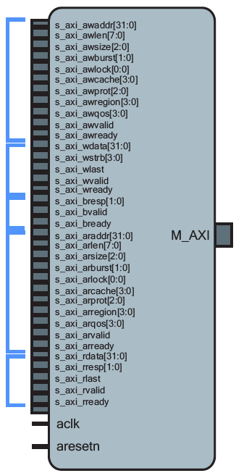
AXI4 Interface
Open block design and click on M_AXI_GP0 + to open its interface.
Write Address Channel
Write Data Channel
Write Response Channel
Read Address Channel
Read Data Channel
Source: M.S. Sadri, Zynq Training
Notes:
The AXI interface has separate and independent read and write channels that can be used simultaneously.
Each channel has its own address and data buses.
Both channels are non-posted; that is, there is always a response.
In the read case the response is simply the read data coming back.
For a write, a separate response bus acknowledges data delivery
Summary of the five AXI channels:
Read address channel
Read data channel
Write address channel
Write data channel
Write response channel

Slide 38
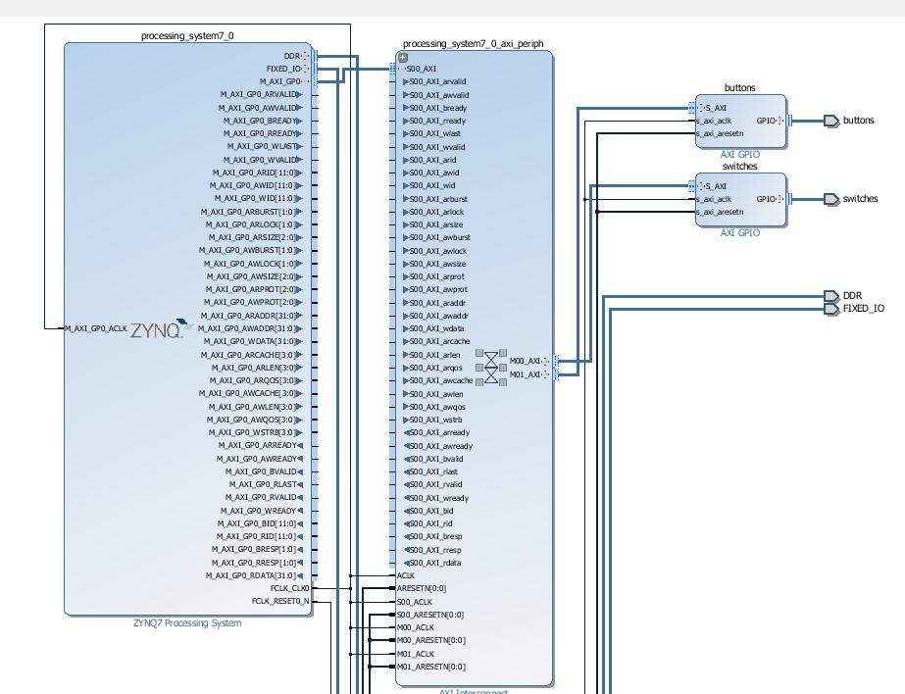
ARM CPU – Master interface – Crossbar Interconnect – Slave interfaces – peripherals
Notes:
The AXI interface has separate and independent read and write channels that can be used simultaneously.
Each channel has its own address and data buses.
Both channels are non-posted; that is, there is always a response.
In the read case the response is simply the read data coming back.
For a write, a separate response bus acknowledges data delivery
Summary of the five AXI channels:
Read address channel
Read data channel
Write address channel
Write data channel
Write response channel

Slide 39
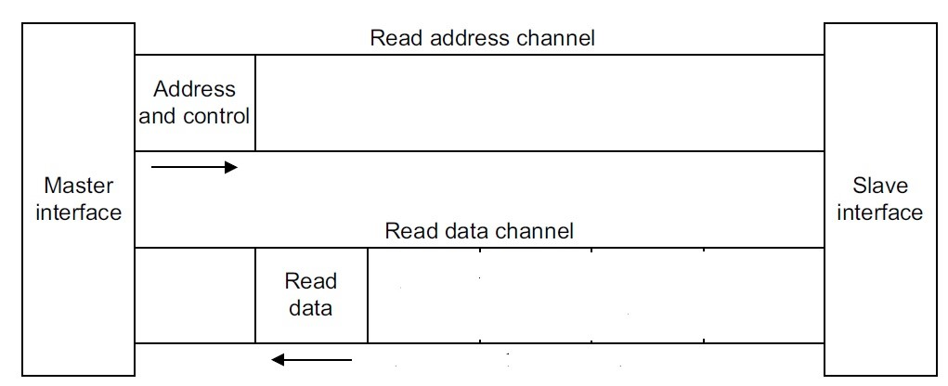
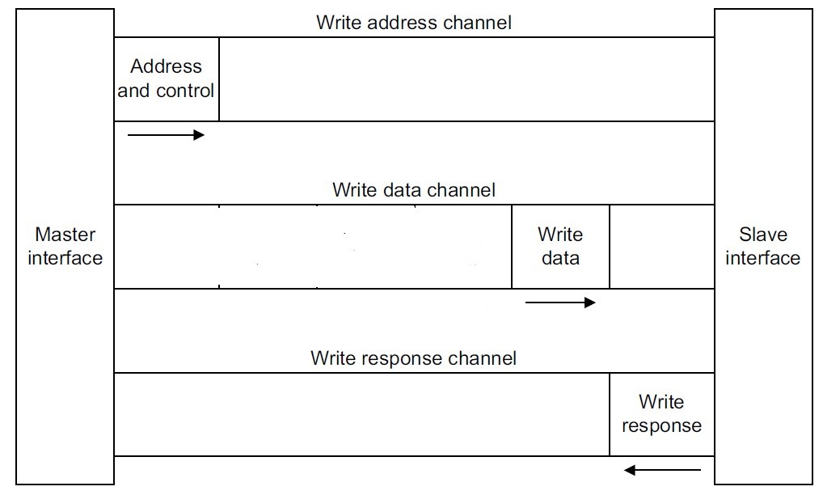
The AXI Interface—AXI4-Lite: no burst
No burst – one word at a time
32 bit or 64 bit words
Data width 32 or 64 only
Xilinx IP only supports 32-bits
Very small footprint
Bridging to AXI4 handled automatically by AXI_Interconnect (if needed)
AXI4-Lite Read
AXI4-Lite Write

Slide 40
The AXI Interface—AX4-Lite: Burst
Sometimes called “Full AXI” or “AXI Memory Mapped”
Not ARM-sanctioned names
Single address multiple data
Burst up to 256 data beats
Data Width parameterizable
1024 bits
AXI4-Lite Read
AXI4-Lite Write

Slide 41
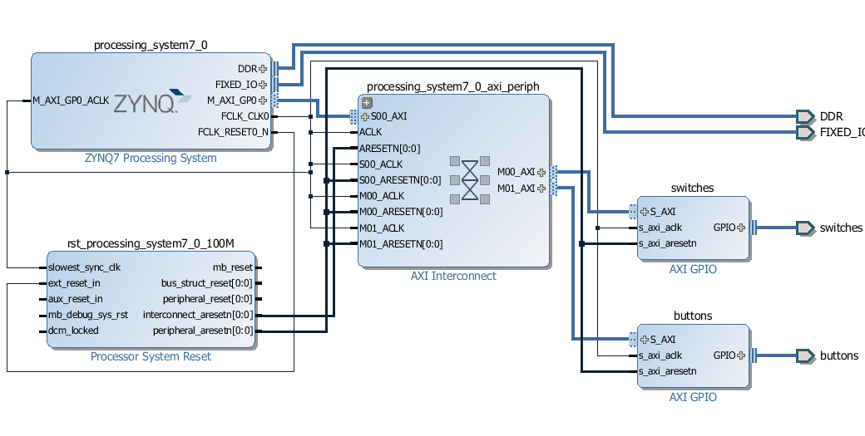
PS7 is master: M_AXI_GP0 – S00_AXI – M00_AXI – S-AXI to switches
PS7 is master: M_AXI_GP0 – S00_AXI – M01_AXI – S-AXI to buttons

Slide 42
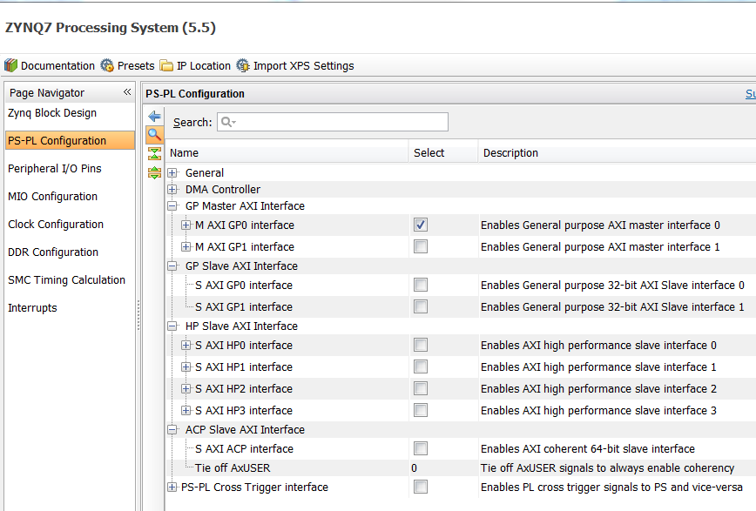
ZYNQ7 PS can be master or slave for PS-PL
2 GP Master, 2 GP Slave, 4 HP Slave, 1 ACP Slave
All are 32 bits

Slide 43
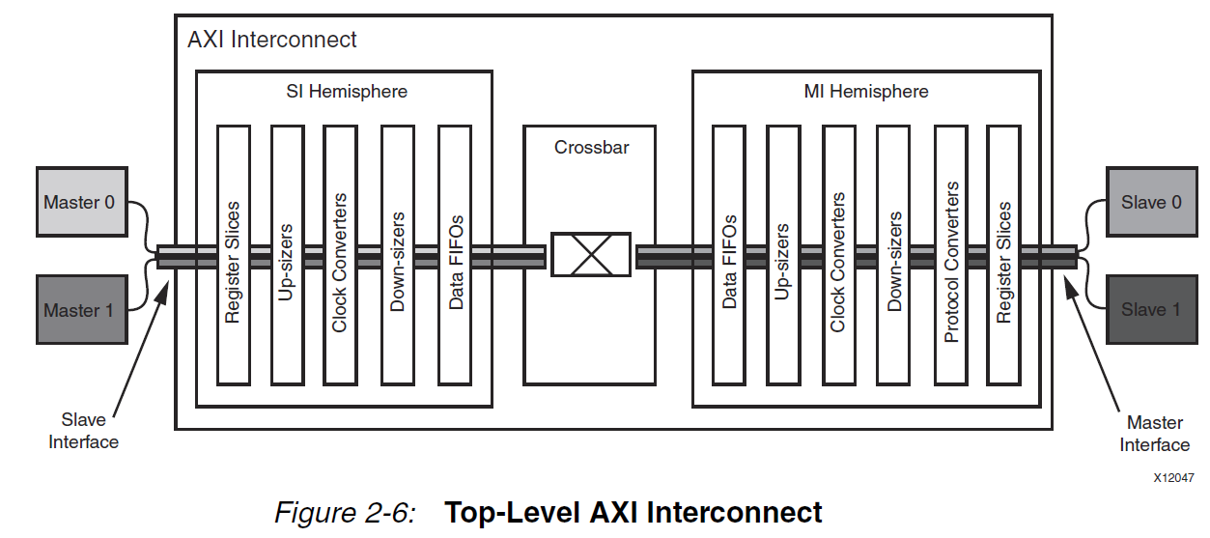
AXI Top-Level Interconnect
interfaces
network
interfaces
circuit
circuit
AXI Reference Guide, UG761 January 18, 2012

Slide 44
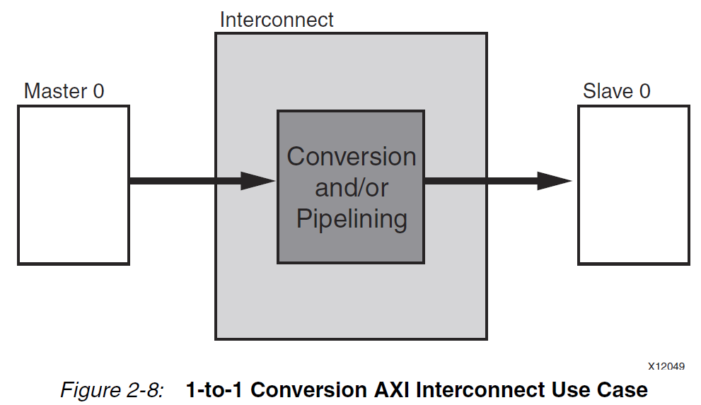
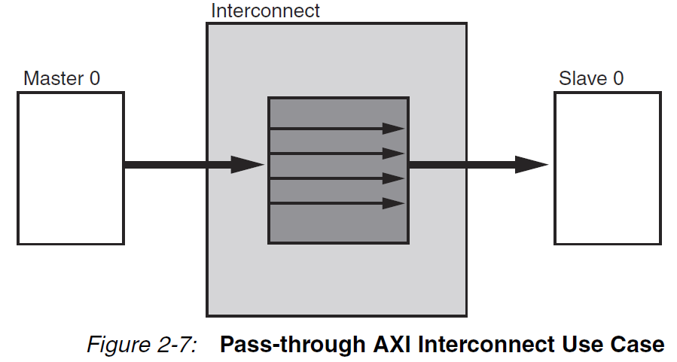
AXI Top-Level Interconnect
AXI Reference Guide, UG761 January 18, 2012

Slide 45

AXI Top-Level Interconnect
AXI Reference Guide, UG761 January 18, 2012

Slide 46




AXI4 Signal Differences between AXI4 and AXI4-Lite

Slide 47


AXI Lite interfaces for Buttons and led_ip_0

